Slide 1
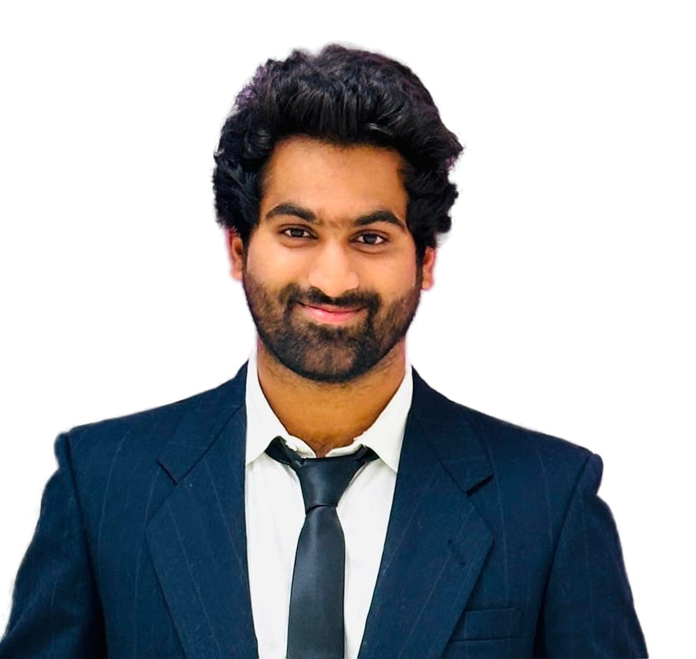


PORTFOLIO
I am a dedicated Mechanical Engineer with a strong background in product design, thermal analysis, and structural optimization, complemented by expertise in CAD modeling, simulation tools, and programming. My experience in startups and industrial R&D has honed my adaptability, problem-solving skills, and ability to deliver high-impact solutions. With a passion for innovation and continuous learning.
Srivatsav Josuyla
josuyla.s@ufl.edu +1 352 740 4385

Slide 2


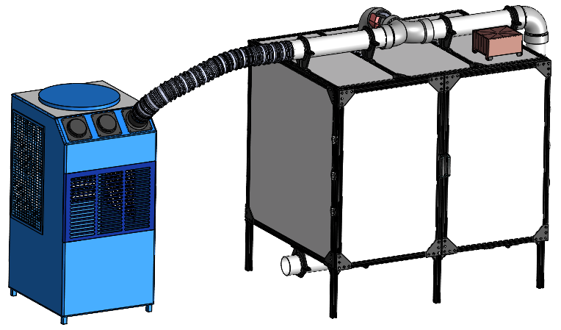
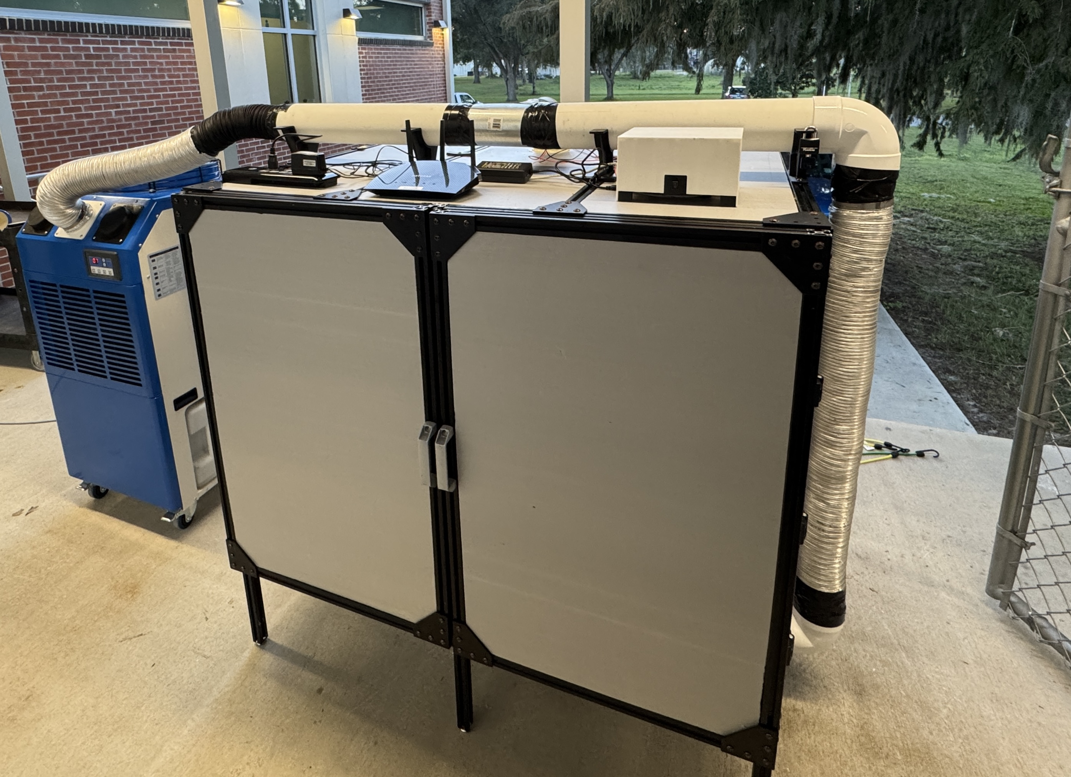
Project -Growth Chamber-Rapid Breeding Graduate Student Researcher
Unlocking the Future of Blueberries: 🌿
🔬 Imagine a world where blueberries grow twice as fast, thriving in a perfectly controlled environment.
Inside this compact, chamber, blueberries experience an optimized climate 24/7. With automated temperature, light, and humidity control, plants can flourish as if nature itself is accelerating their growth.
💡 How It Works: ✔️ A custom-built chamber simulates day and night cycles, ensuring consistent development. ✔️ A Raspberry Pi brain provides real-time monitoring & remote access. ✔️ Designed for precision, this innovation enhances breeding efficiency like never before.

Slide 3
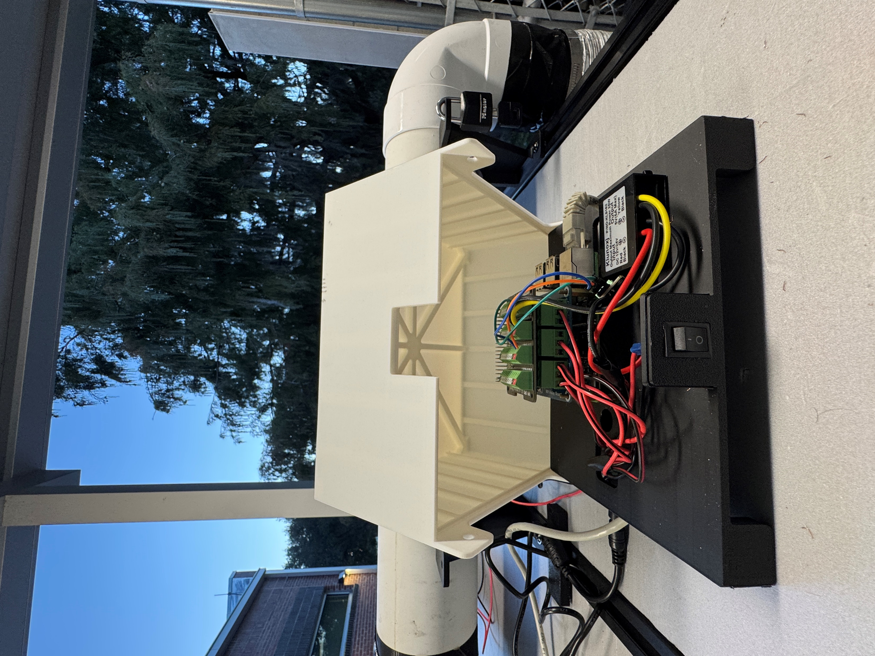
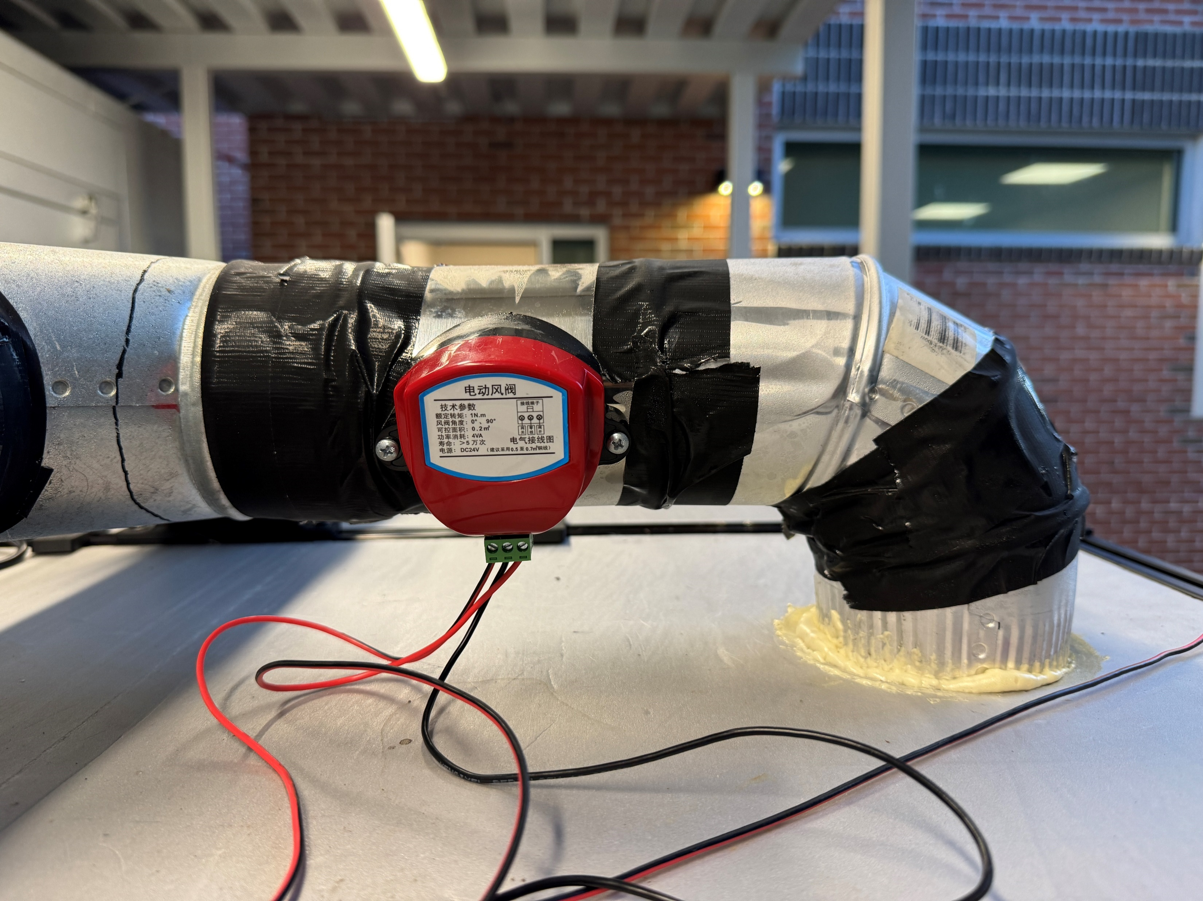
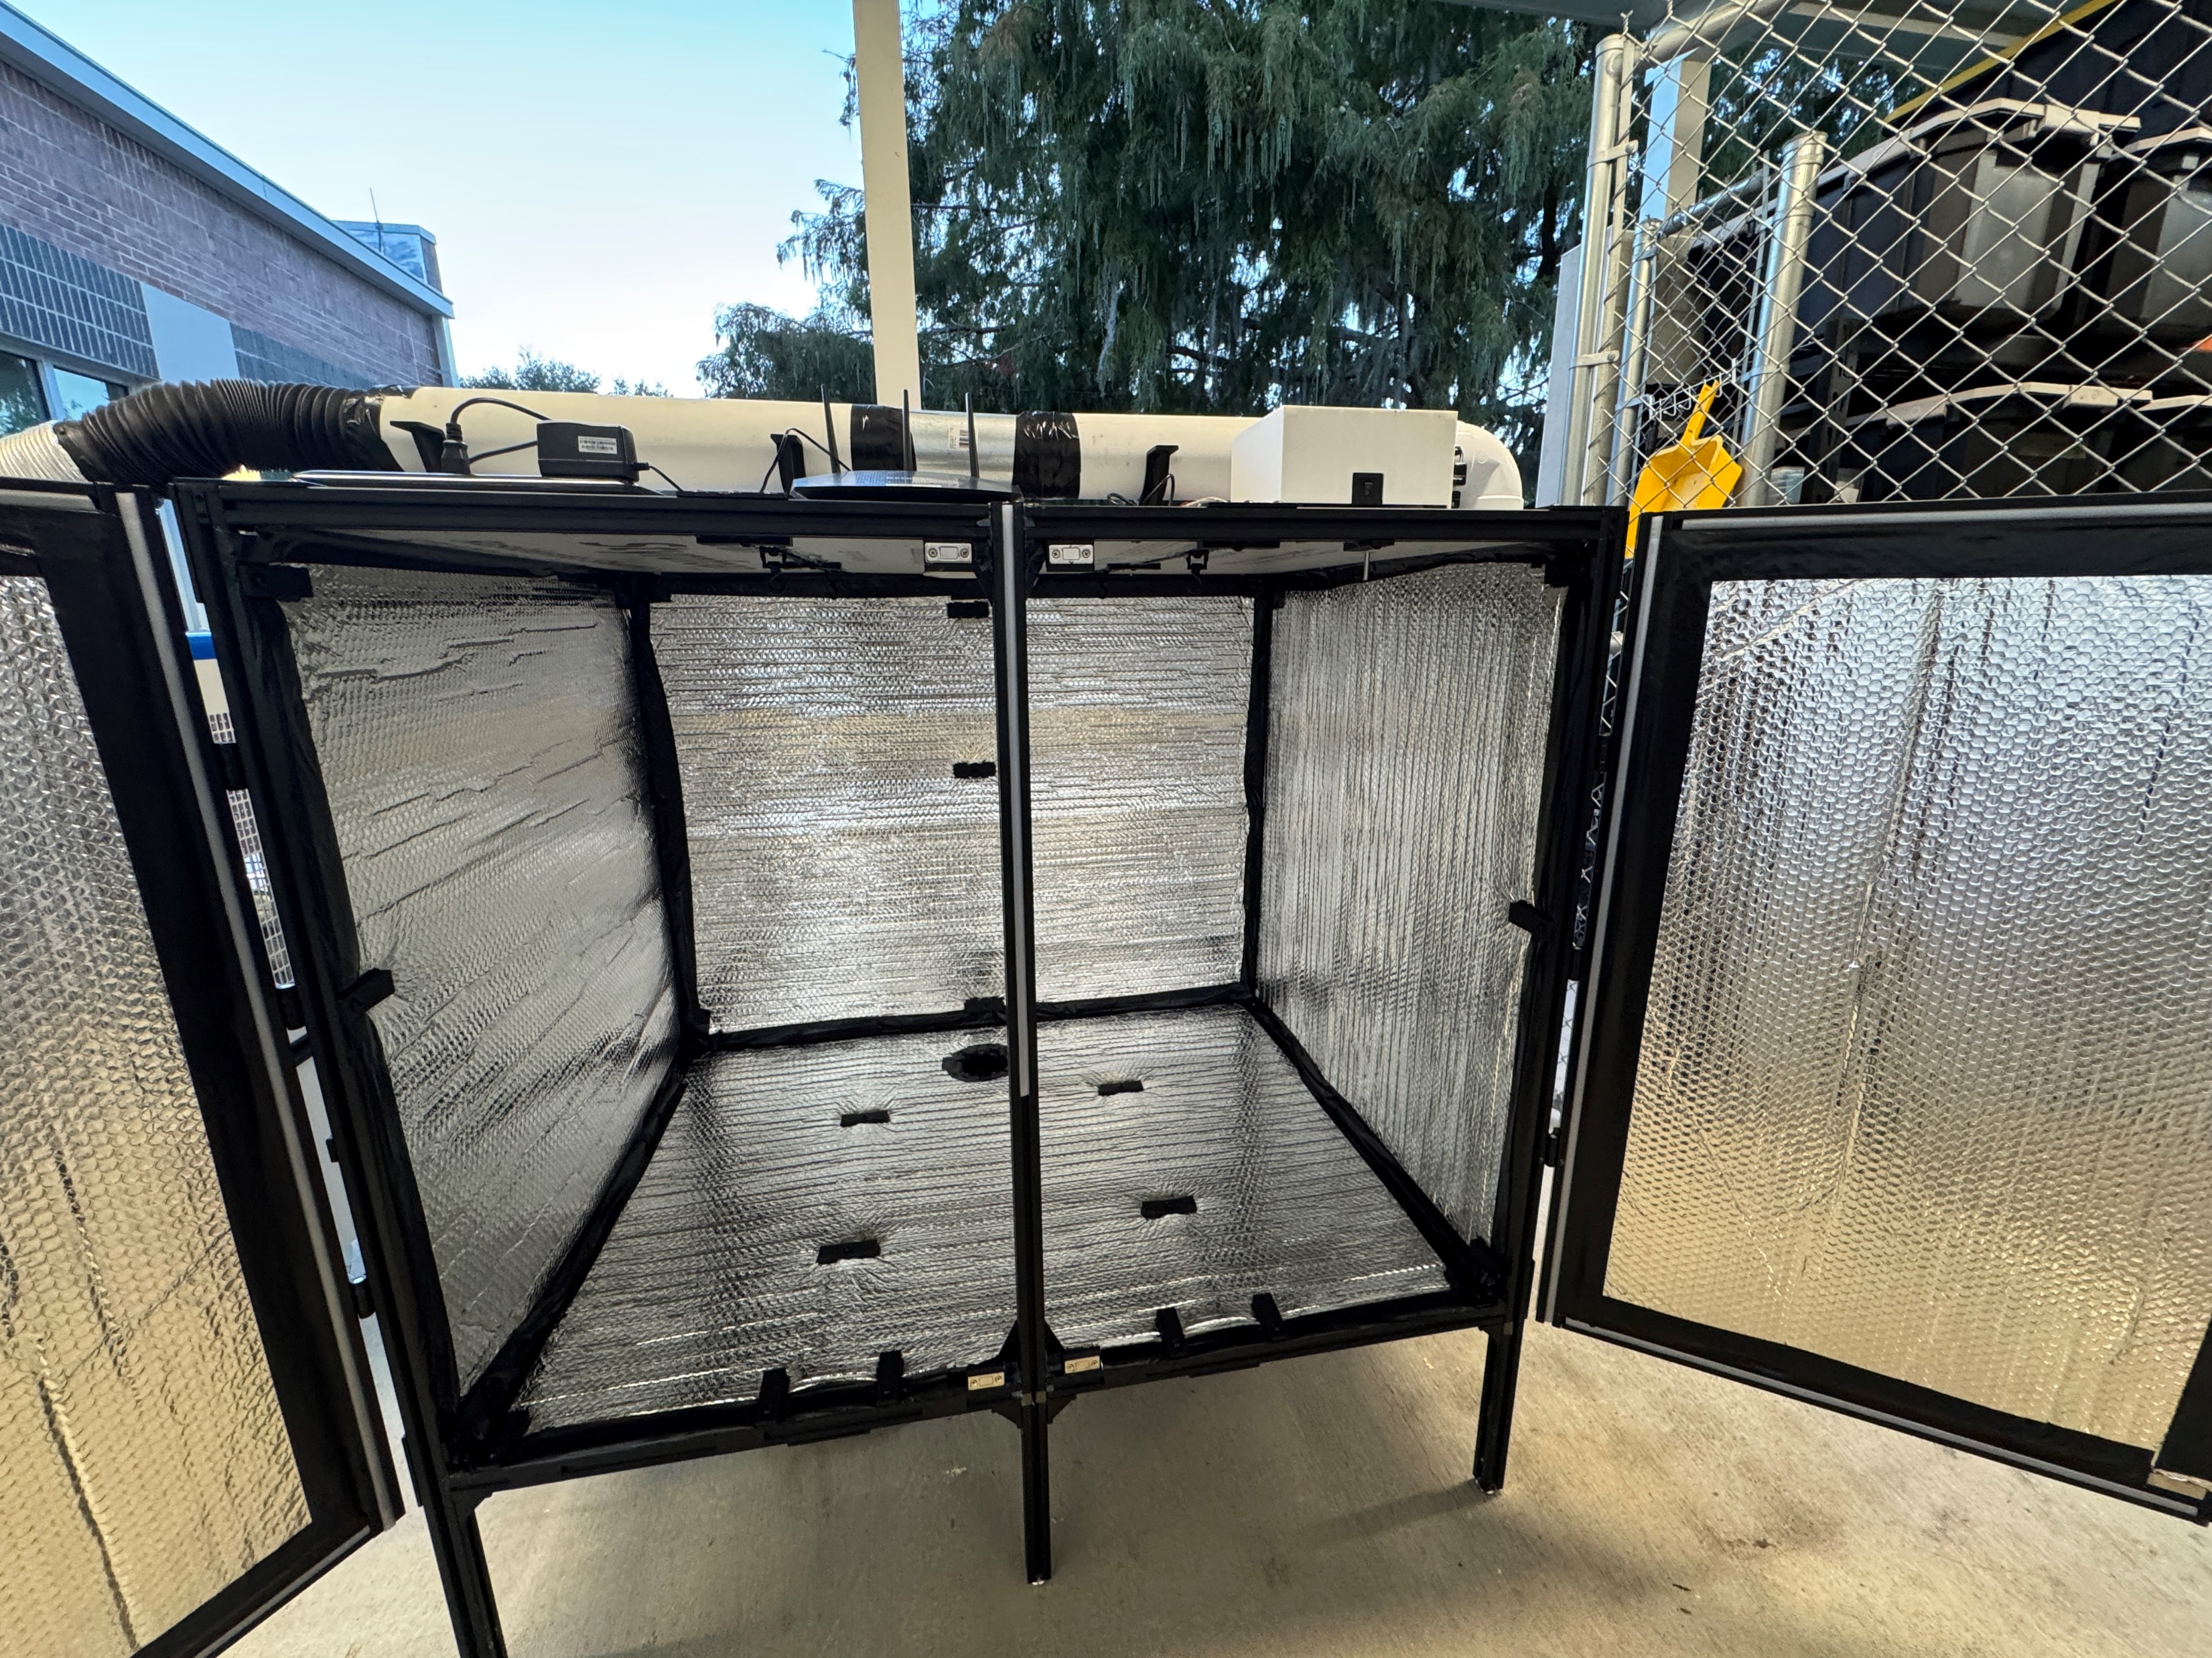
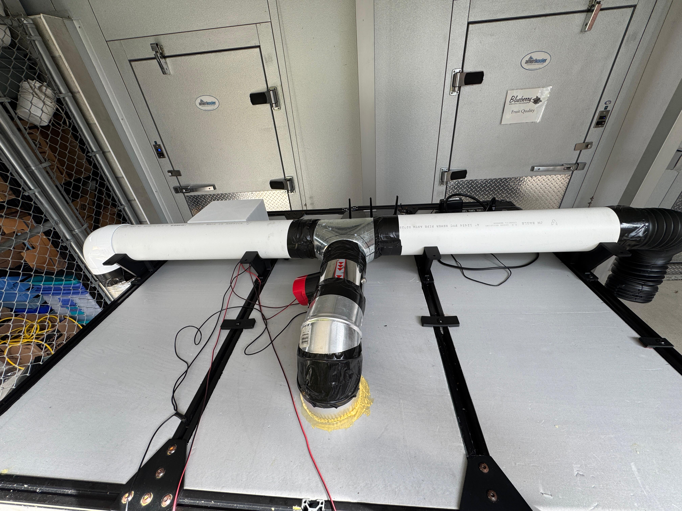
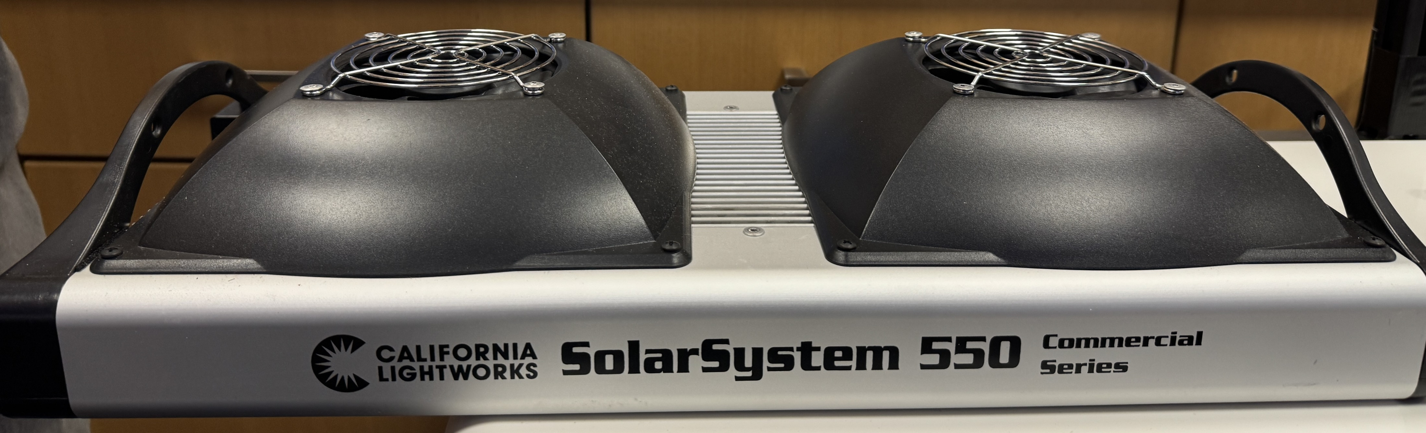
🔧 Growth Chamber System Overview
1️⃣ Climate Control & Airflow
Integrated HVAC system regulates temperature and humidity.
Control valves manage airflow distribution for uniform conditions.
Efficient air conditioning system ensures stability in different environments.
2️⃣ Insulation & Lighting
Well-insulated chamber minimizes external temperature fluctuations.
RGB lighting system provides adjustable light settings for different growth stages.
3️⃣ Automation & Monitoring
Electronics-based automation enables precise environmental control.
Temperature sensors track real-time data for optimized conditions.
System runs on a Raspberry Pi, allowing for remote monitoring and adjustments.
Control Valves
Electronics
Insulation
HVAC
RGB Lighting System
HVAC System

Slide 4

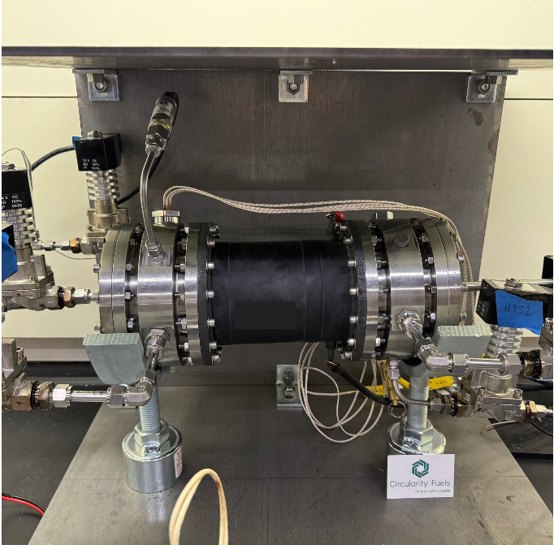
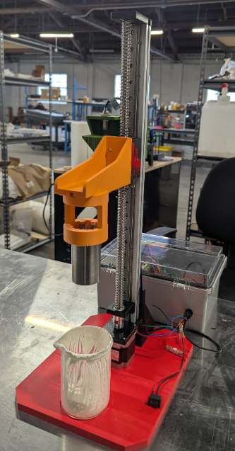
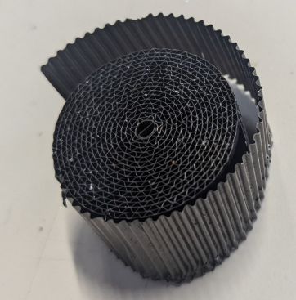
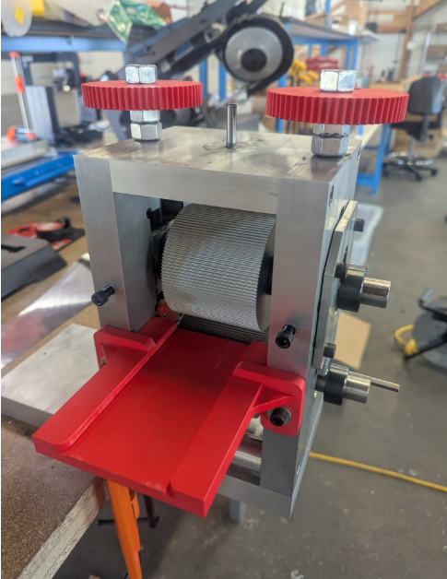
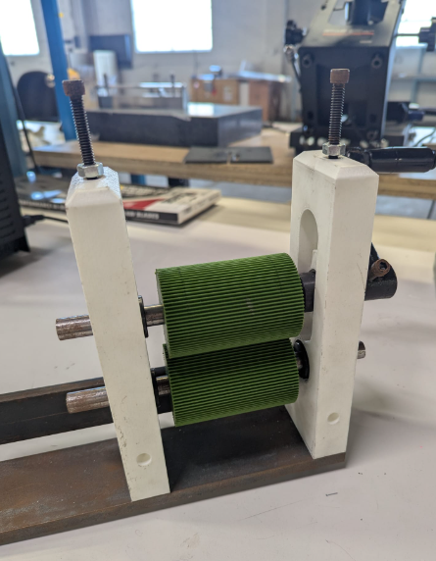
Chemical Pilot Reactor Role: Mechanical Engineering Intern Duration: Aug 2024 – Jan 2025
🔹 System Overview
Designed and optimized a chemical reactor system for efficient catalyst integration, improving reaction kinetics and thermal management
🔹 Key Contributions: ✔ Reactor Structural Design – Developed SolidWorks-based reactor layout within a shipping container. ✔ Designed a Jig for corrugation. ✔ Flow Optimization – Designed corrugated catalyst sheets, enhancing flow distribution by 20% for improved reaction efficiency. ✔ Designed a Dip coating machine. .
Chemical Reactor
Corrugated Sheet
Dip Coating Machine
Corrugation Jig
3 D printed Corrugation Jig

Slide 5

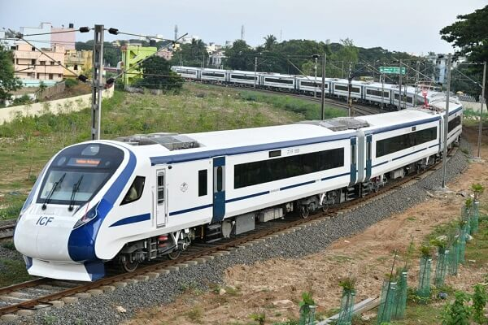
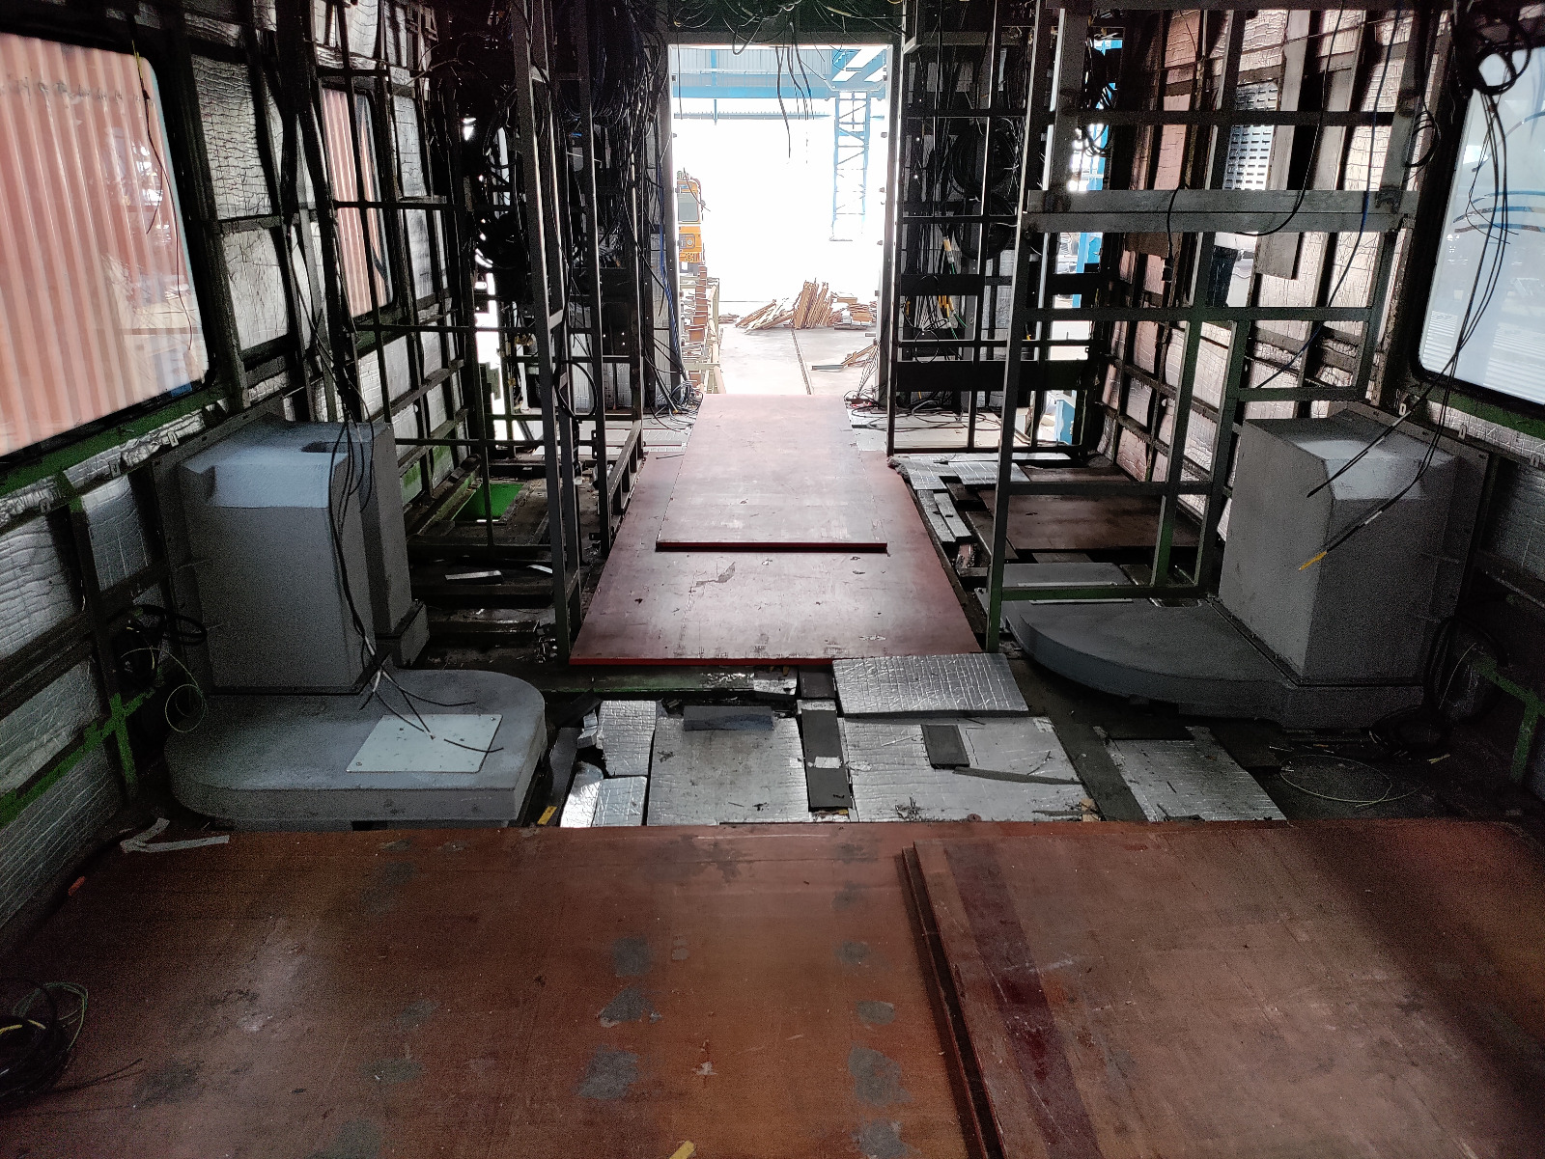
Professional Experience
🚄 Project 1: Air Duct Design for Vande Bharat Express-freight R&D Mechanical Engineer | Duration: Sep 2021 – May 2023
🔹 System Overview
Developed an airflow management system for traction motor cooling, optimizing heat dissipation for high-speed train applications. The project focused on reducing thermal loads, improving system durability, and ensuring compliance with railway standards.
🔹 Key Contributions: ✔ CFD-Optimized Air Ducts – Increased cooling efficiency by 15%, minimizing pressure drop. ✔ FEA & Structural Analysis – Ensured duct durability by simulating loads. ✔ Thermal Performance Simulation – Evaluated temperature gradients & airflow to enhance efficiency. ✔ Manufacturing & Quality Control – Led fabrication inspections and ensured GD&T compliance.

Slide 6
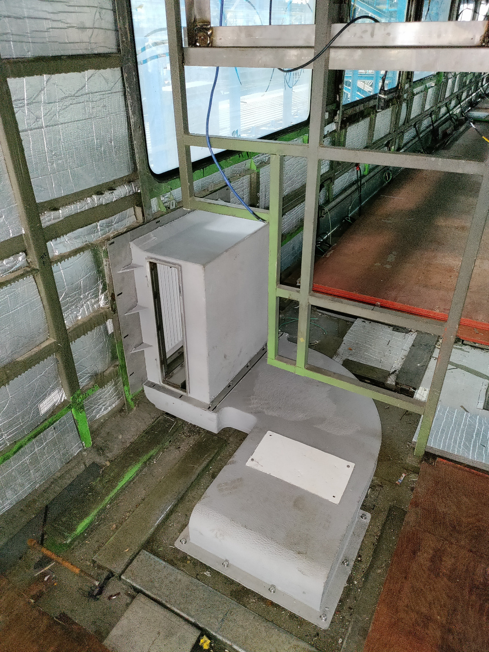
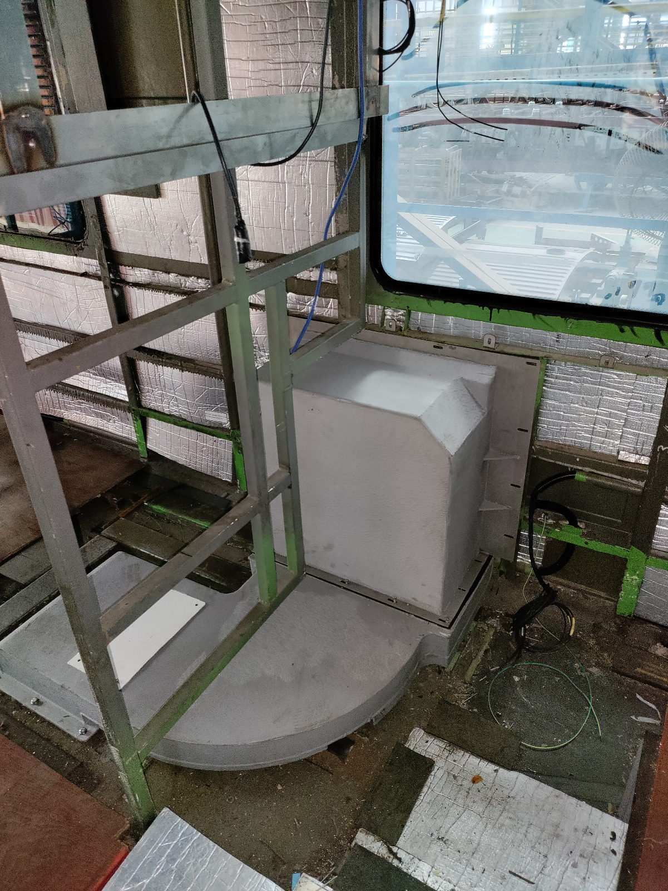
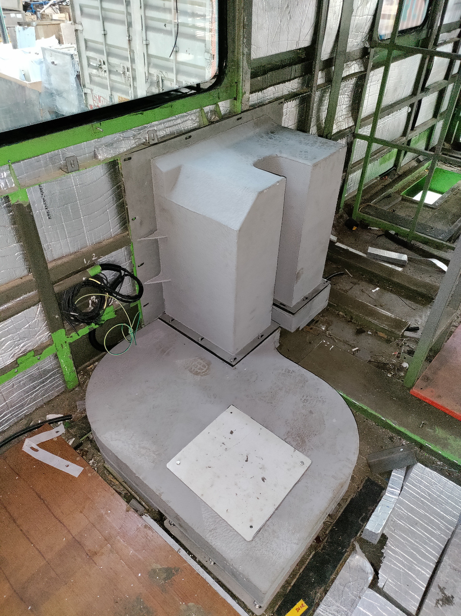
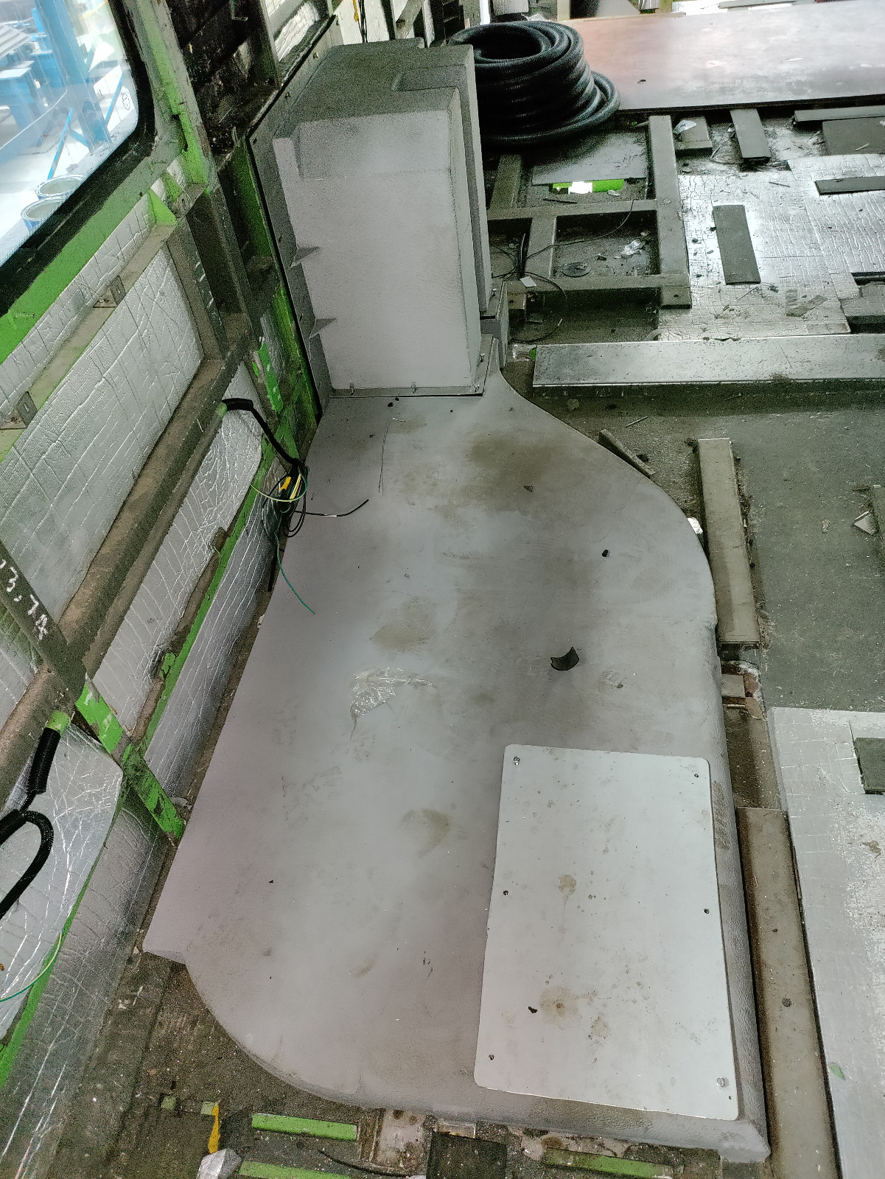
Professional Experience
Ducts Installation in the field.
Traction Motor 1 Air duct
Traction Motor 2 Air duct
Traction Motor 3 Air duct
Traction Motor 4 Air duct
🔹 Key Contributions ✔ 8 Ducts of each type were manufactured and installed.
✔ Negotiated with suppliers to maintain cost efficiency, while ensuring compliance with engineering specifications.

Slide 7
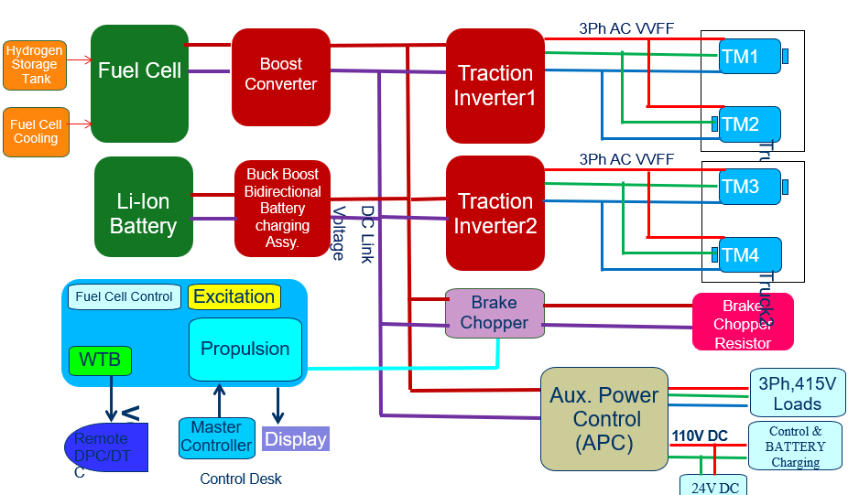
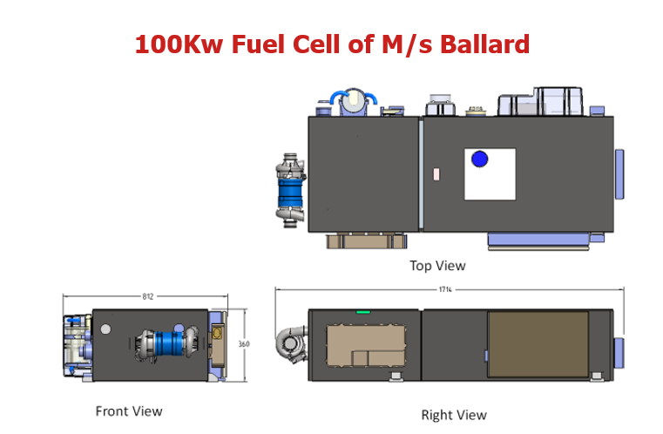
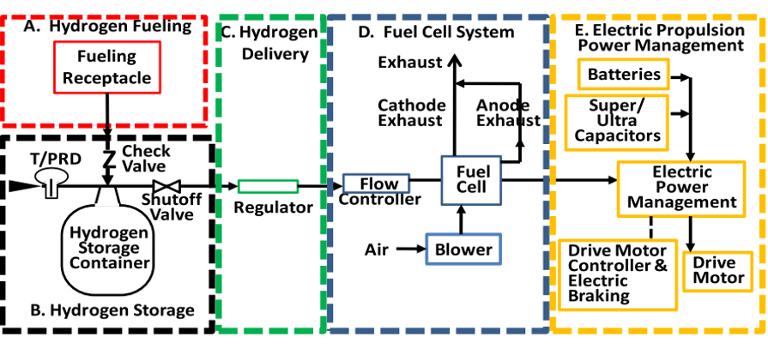
Professional Experience
🚄 Project 2: Hydrogen Fuel Cell DEMU
🔹 System Overview
The project involved designing an advanced thermal management system for a hydrogen-powered Diesel Electric Multiple Unit (DEMU), integrating active cooling strategies to enhance fuel cell efficiency.
🔹 Key Contributions: ✔ Designed a structural cooling system to support heat exchangers and blowers, replacing traditional HVAC.
✔ FEA & Structural Analysis – Validated load-bearing capacity.
✔ Optimized Weight – Reduced system weight by 12% while ensuring high structural efficiency. ✔ Thermal Performance Simulation – Evaluated temperature gradients & airflow to enhance efficiency.

Slide 8

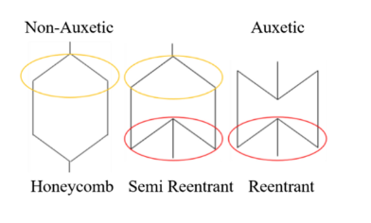
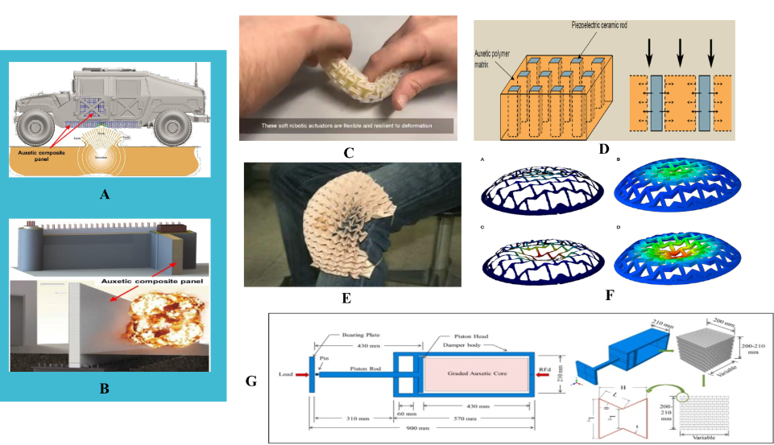
"Study of Hierarchically Architectured Materials Research Assistant | Duration: Feb 2021 – May 2021
🔹 System Overview
Investigated auxetic structures to enhance mechanical resilience, flexibility, and energy absorption in engineering applications.
🔹 Key Contributions: ✔ FEA Analysis & Optimization – Simulated stress distribution & deformation patterns using Autodesk Fusion 360 to determine optimal auxetic configurations. ✔ Material Performance Evaluation – Assessed load-bearing capacity, impact resistance, and flexibility across multiple auxetic structures.

Slide 9
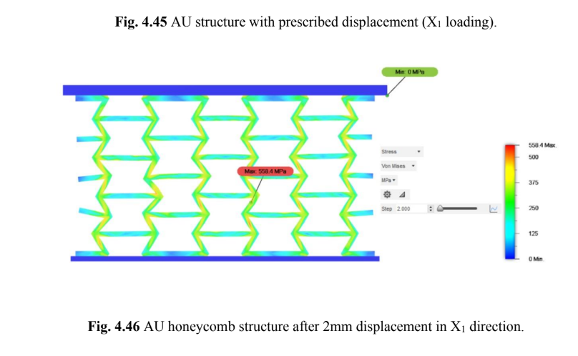
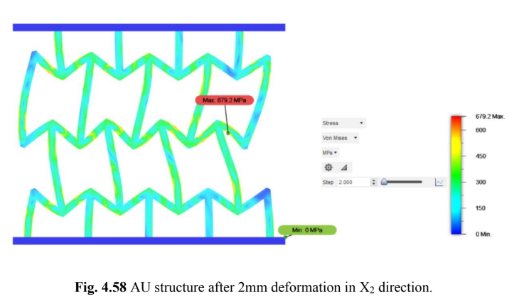
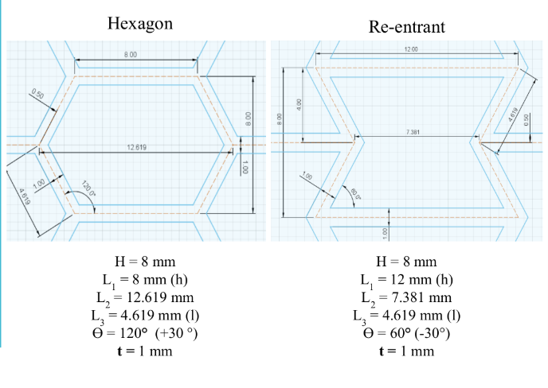
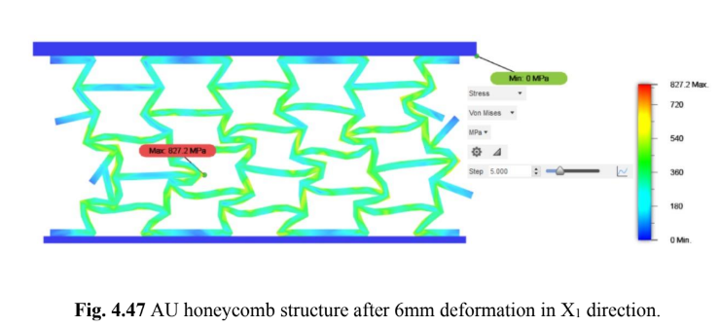
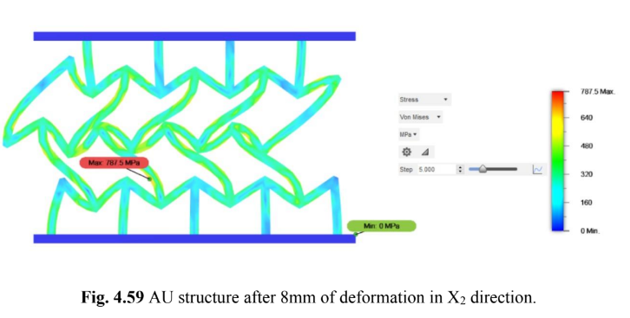
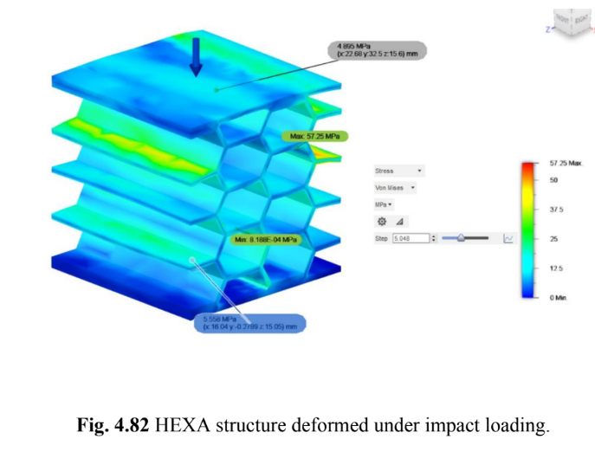
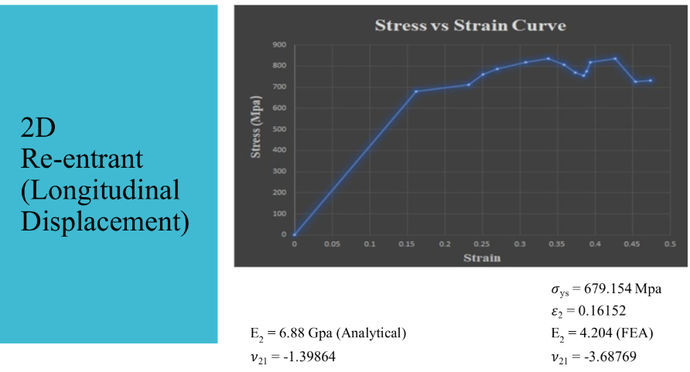
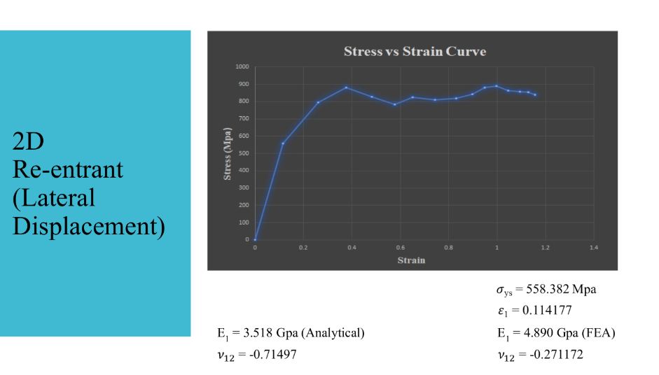
Results and observations

Slide 10
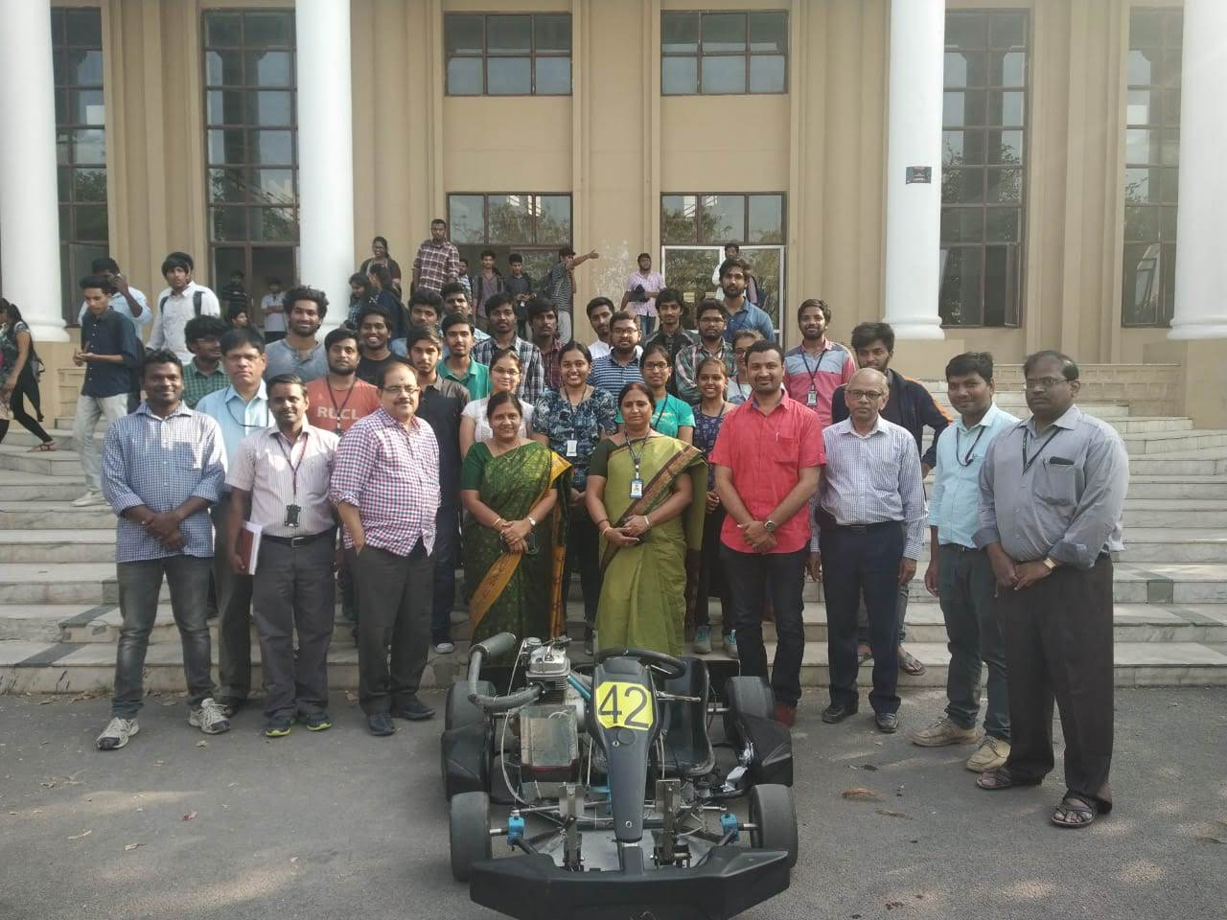
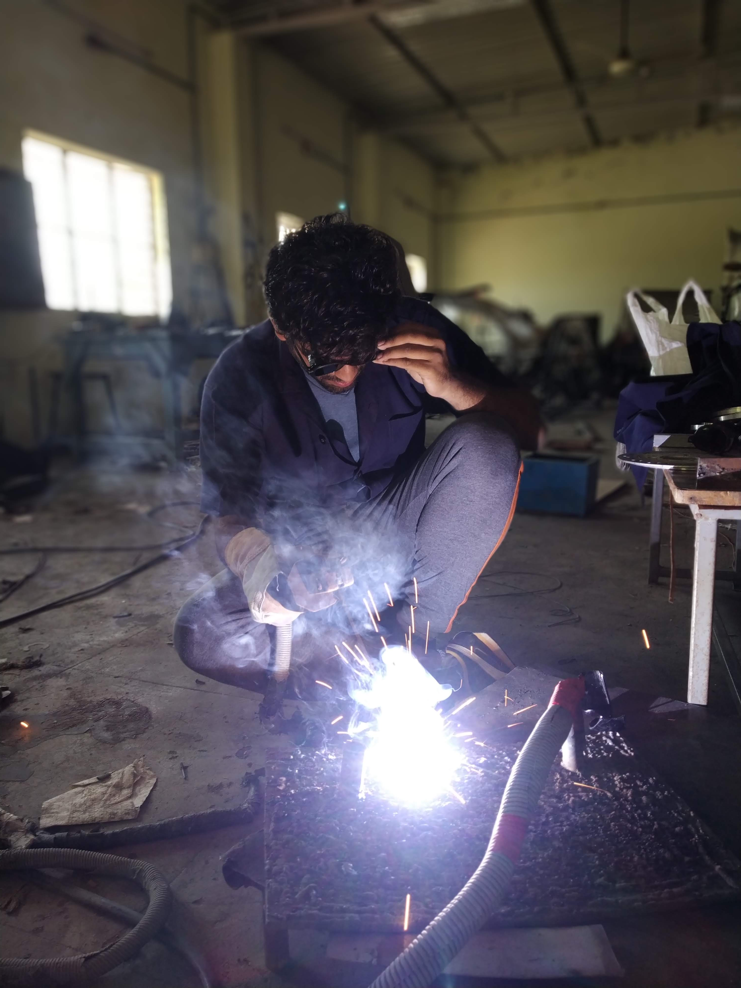
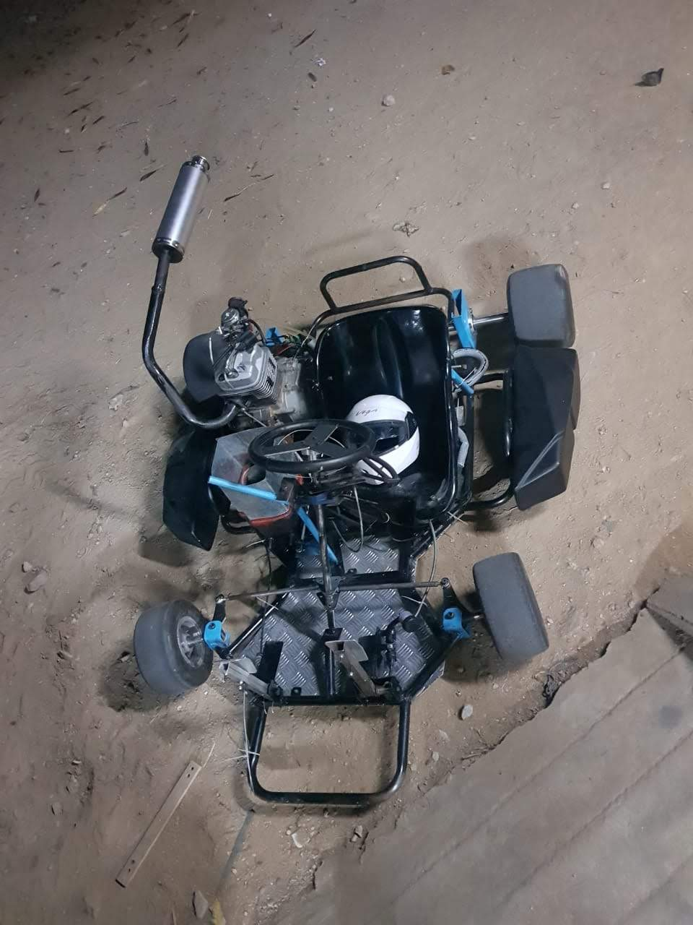
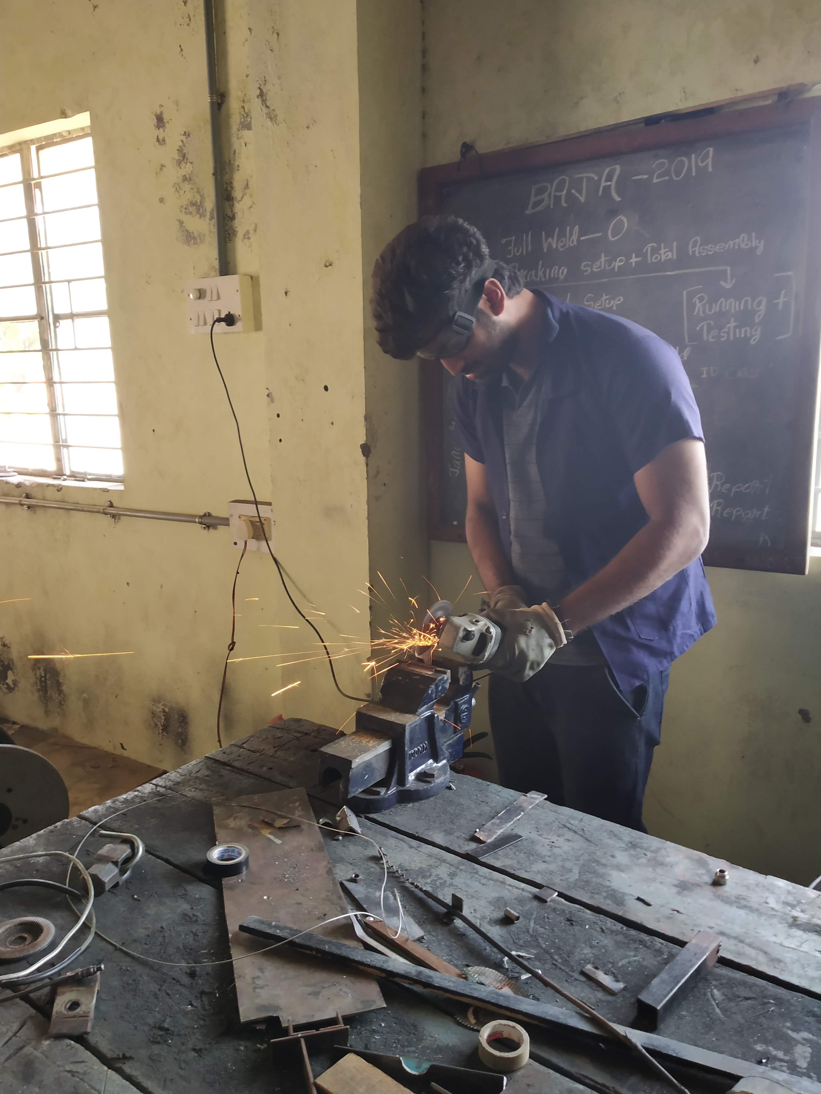
Go-Kart Team –INITIA 3.0
Bake Team Head Duration: July 2018 - March 2019
🔹 System Overview A competition involving the design, analysis and fabrication of a student Go-Kart vehicle by a team of 25 students from undergraduate classification to compete in several events such as Braking test, Acceleration test, Skid Pad and Endurance Race that test the performance of the vehicle fabricated.
🔹 Key Contributions:
✔ Designed and optimized a high-performance braking system in SolidWorks, ensuring enhanced safety & efficiency. ✔ Conducted theoretical calculations for braking torque, caliper sizing, piston dimensions, hub, and disc specifications
✔ FEA & Structural Analysis – Validated load-bearing capacity of the Pedal.

Slide 11
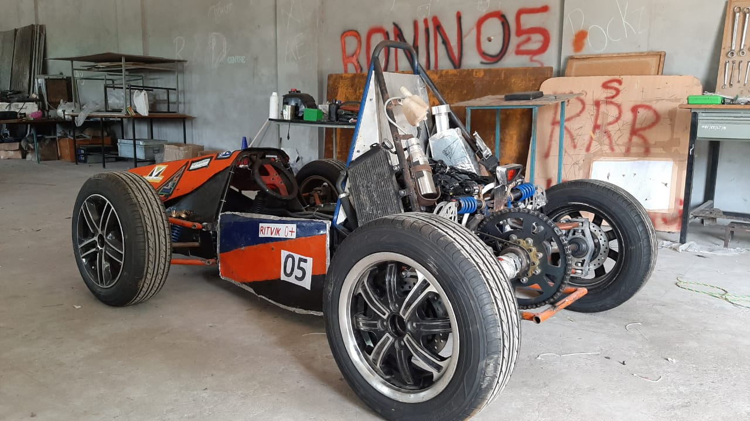
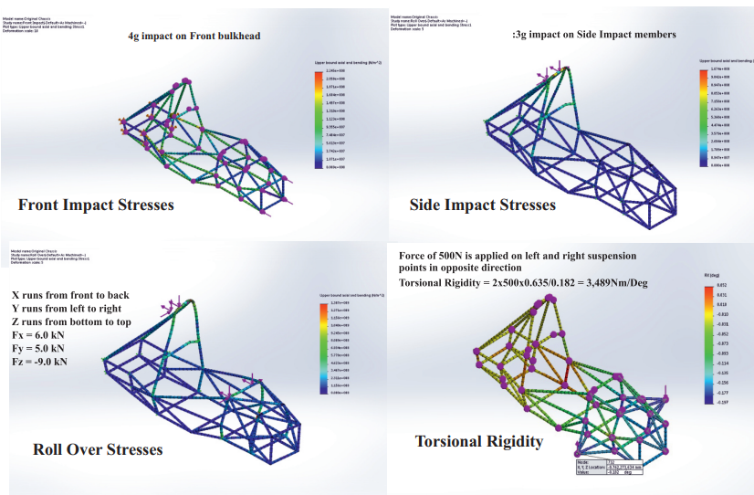
Team Ampere Motorsport India Supra-SAE India Student Formula Duration: Nov 2018 -Aug 2019
🔹 System Overview A competition involving the design, analysis and fabrication of a student formula vehicle by a team of 25 students from undergraduate classification to compete in several events such as Braking test, Acceleration test, Skid Pad and Endurance Race that test the performance of the vehicle fabricated.
🔹 Key Contributions: One of the most cost-effective designs in the competition
Complete in-house fabrication of components
373.2 cc (22.77 cu in) 4-stroke, liquid-cooled single cylinder engine
Bybre 2 piston calipers with 230mm Slotted Rotors in all 4 corners
ECU Tuning and custom mapping to have high initial torque
Fiber Reinforced Polymer Body panels
Designed for 95th Percentile Male criterion
Generative Design for Suspension Parts

